Slide 1
COMP-421 Compiler Design
Presented by
Dr Ioanna Dionysiou

Slide 2
Administrative
[ALSU03] Chapter 3 - Lexical Analysis
  Sections 3.1-3.4, 3.6-3.7
Reading for next time
  [ALSU03] Chapter 3

Slide 3
Lecture Outline
Role of lexical analyzer
  Issues, tokens, patterns, lexemes, attributes
Input Buffering
  Buffer pairs, sentinel
Specification of tokens
  Strings, languages, regular expressions and definitions
Recognition of tokens
  Transition diagrams
Finite Automata
  NFA, DFA

Slide 4
Role of Lexical Analyzer
Source
Program
Lexical Analyzer
token
Syntactic Analyzer
(parser)
…….
get
next token
Symbol
Table
First phase of a compiler
read input characters until it identifies the next token

Slide 5
Lexical Analyzer Phases
Sometimes, are divided into two phases
  Scanning
    Simple tasks
      Eliminating white spaces and comments
  Lexical analysis
    More complex tasks

Slide 6
Lexical and Syntax Analysis
Why separating lexical analysis from syntax analysis?
  Simple design is the most important consideration
    Low coupling, high cohesion
  Compiler efficiency is improved
  Compiler portability is enhanced
Notes:
Specialized buffering techniques
Input device specific peculiarities can be restricted to lexical analyzer

Slide 7
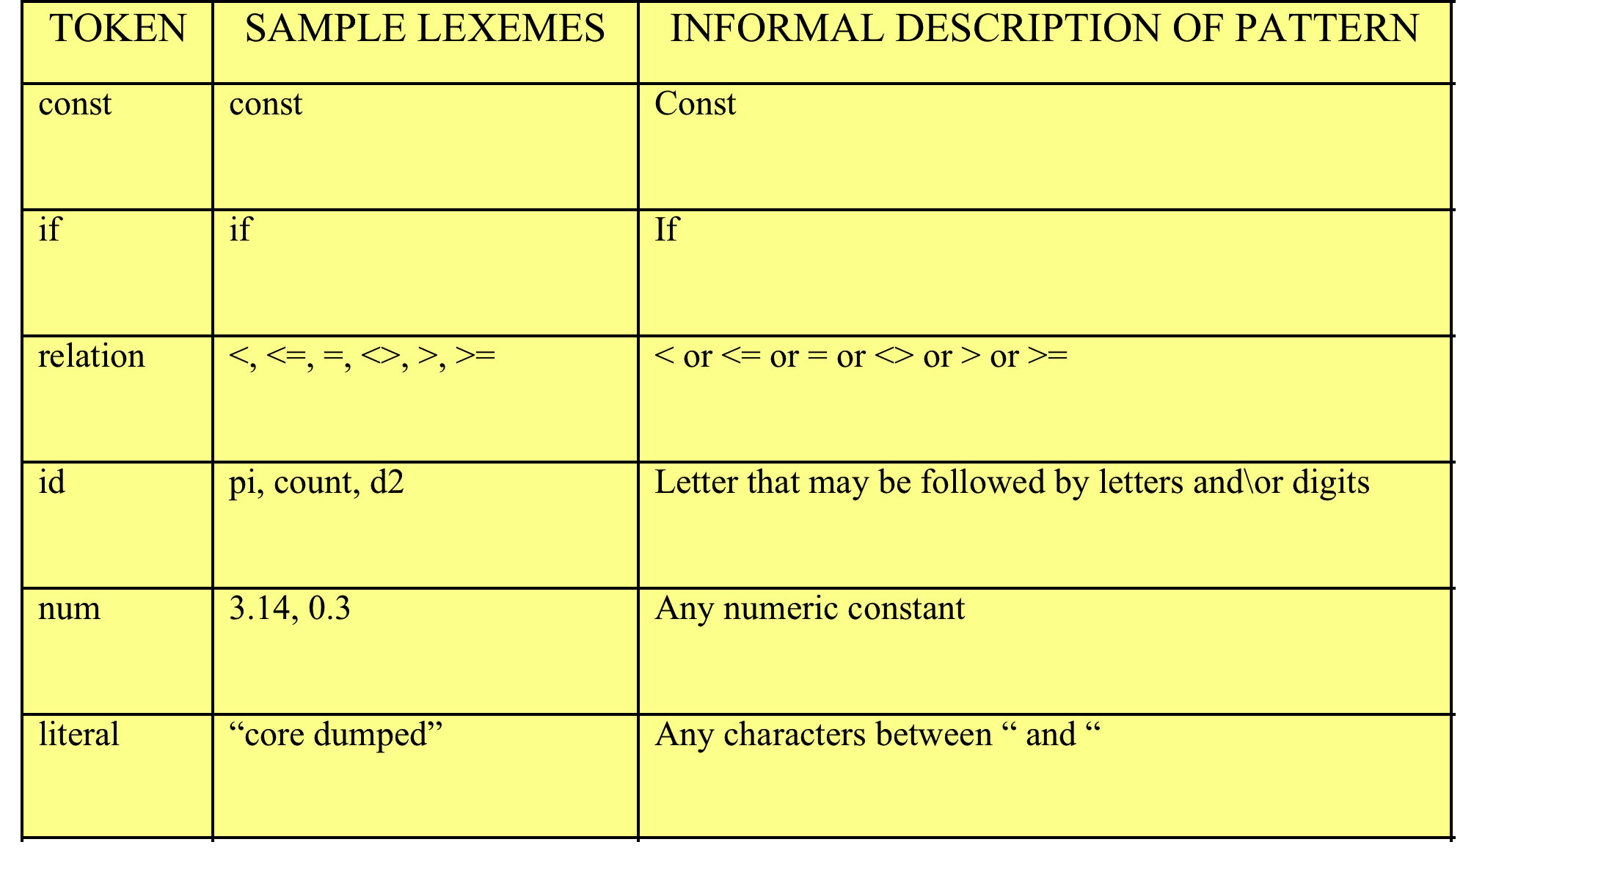
Tokens, patterns, lexemes
pi is a lexeme for the token identifier id
The pattern for token id matches the string pi
The pattern for token id is a sequence of letters and\or digits, where the sequence always start with a letter
Notes:
for count:=1 to N do
For token for
Count token id
:= token assignment
1 num
To token to
N token id
Do token do
For id assignment (num|id) to (num|id) do

Slide 8
Tokens, lexemes, patterns
Token
  Terminals in the grammar for the source language
Lexeme
  Sequence of characters in the source program that is matched by the pattern for a token
Pattern
  Rule describing the set of lexemes that can represent a particular token in source programs

Slide 9
Attributes for tokens
What happens when more than one lexemes is matched by a pattern?
Lexeme 0
Lexeme 1
Pattern for token num matches both lexemes 0 and 1

Slide 10
Attributes for tokens
It is essential for the code generator to know what string was actually matched
  Token Attributes
    Information about tokens
    A token has a single attribute
      Pointer to the symbol-table entry
        <token, pointer>
      Lexeme and line number
  Question: Do all tokens need to have an entry in the symbol-table?
Notes:
Token name influences parsing decisions but attribute values influence translation of tokens after parsing

Slide 11
In-class Exercise
if A < B
Identify the tokens and their associated attribute-values

Slide 12
Solution
if A < B
<if,null >
<id, pointer to symbol-table entry for A>
<relation, pointer to symbol-table entry for < >
<id, pointer to symbol-table entry for B>

Slide 13
Lexical Errors
fi (0)
  misspelling for the keyword if
  function identifier
There are cases where the error is clear
  None of the patterns for tokens matches the remaining input
  Error-recovery actions
    Examples?

Slide 14
Lecture Outline
Role of lexical analyzer
  Issues, tokens, patterns, lexemes, attributes
Input Buffering
  Buffer pairs, sentinel
Specification of tokens
  Strings, languages, regular expressions and definitions
Recognition of tokens
  Transition diagrams
Finite Automata
  NFA, DFA

Slide 15
Input Buffering Issues
Three approaches to the implementation of a lexical analyzer
  Use a lexical-analyzer generator
  Write a lexical analyzer in a systems programming language using the I/O provided
  Write a lexical analyzer in assembly and explicitly manage the reading of input

Slide 16
Buffering
Lexical analyzer may need to look ahead several characters beyond the lexeme for pattern before a match can be announced
  ungetc pushes lookahead characters back into the input stream
  Other buffering schemes to minimize the overhead
    Dividing a buffer into 2 N-character halves
      Load N characters into each buffer half using a single read command
      Use eof special character to signal the end of the source program

Slide 17
Lecture Outline
Role of lexical analyzer
  Issues, tokens, patterns, lexemes, attributes
Input Buffering
  Buffer pairs, sentinel
Specification of tokens
  Strings, languages, regular expressions and definitions
Recognition of tokens
  Transition diagrams
Finite Automata
  NFA, DFA

Slide 18
Specification of Tokens
Strings and languages
  Alphabet, character class
    Finite set of symbols
    {0,1} is the binary alphabet
  String, sentence, word
    ….over some alphabet is a finite sequence of symbols drawn from that alphabet
      0100001 is a string over the binary alphabet of length 7
        230001 is not a string over the binary alphabet
      Empty string ε
  Language
    Set of strings over fixed alphabet
Notes:
ASCII character set

Slide 19
More on strings
Suppose x, y are strings
  Concatenation of x and y
    x = school y = work
    xy = schoolwork
    x ε = ε x = x
  Exponentiation of x
    x⁰ = ε
    x¹ = x
    x² = xx
    x^{i} = x^{i-1}x

Slide 20
More on strings…
Consider s = school
  What is….
    Prefix of s
    Suffix of s
    Substring of s
    Subsequence of s
  For every string
    both s and ε are prefixes, suffixes, and substrings of s
Notes:
Remove zero or more symbols from the end of s
Remove zero or more symbols from the beginning of s
Removing zero or more symbols from either end
Removing zero or more not necessarily consecutive position of s

Slide 21
Operations on Languages
For lexical analysis, we are interested in the following:
  operations
    Union
    Concatenation
    Closure
    Exponentiation
  A new language is created by applying the operations on existing languages

Slide 22
Union Operation
Consider Languages L= {a,b}, M = {1,2}
  Union of L and M is written as L ∪ M
    L ∪ M = {s | s is in L or s is in M}
    L ∪ M = {a,b,1,2}
Notes:
L is the set {a,b} meaning that L denotes string a and string b

Slide 23
Concatenation Operation
Consider Languages L= {a,b}, M = {1,2}
  Concatenation of L and M is written as LM
    L M = {st | s is in L and t is in M}
    LM = {a1, a2, b1, b2}

Slide 24
Exponentiation Operation
Consider Language L = {a,b}
  L⁰ = {ε}
  L¹ = L = {a,b}
  L² = LL = {a,b}{a,b}={aa,ab,ba,bb}
  …
  L^{i} = L^{i-1}L

Slide 25
Kleene closure Operation
Consider Language L = {a,b}
  Kleene-closure of L is written as L*
    L* = ∪L^{i} with i=0 to ∞
      (union of zero or more concatenations of L)
    L* = {ε,a,b,aa,ab,ba,bb,…}
      L⁰ = {ε}
      L¹ = {a,b}
      L⁰ ∪ L¹ = {ε, a,b}
      L² = {a,b} {a,b} = {aa,ab,ba,bb}
      L⁰ ∪ L¹ ∪ L² = {ε, a,b, aa,ab,ba,bb} …

Slide 26
In-class Exercise
Consider L = {0,1,2} and M ={A,B}. Describe the language that is created from L and M when applying
  Union
  Concatenation (LM , ML)
  Kleene Closure (L)

Slide 27
Solution
L ∪ M = {0,1,2,A,B}
LM = {0A, 0B, 1A, 1B, 2A, 2B}
ML = {A0, A1, A2, B0, B1, B2}
L* = {ε,0,1,2,00,01,02,10,11, 12, 20, 21,22,…}

Slide 28
Regular Expressions (r)
r is about
  notation
  patterns
  expression that describes a set of strings
  a precise description of a set
Notes:
Notation that specifies lexeme patterns, effective for specifying the language patterns that we need for tokens

Slide 29
Regular Expressions Examples
Examples of r
  a|b
    {a,b}
  ab
    {ab}
  a|(ab)
    {a,ab}
  a(a|b)
    {aa,ab}
  a*
    {ε ,a,aa,aaa,…}

Slide 30
r and L(r)
A regular expression is built up by simpler regular expressions using a set of rules
Each regular expression r denotes a language L(r)
  A language denoted by a regular expression is said to be a regular set

Slide 31
Rules that define r over alphabet 
ε is a regular expression that denotes {ε}
  that is the set containing the empty string
If α is a symbol in Σ then α is a regular expression that denotes {α}
  - that is the set containing the string α

Slide 32
Rules that define r over alphabet 
Suppose that r and s are regular expressions denoting languages L(r) and L(s). Then,
  (r)|(s) is a regular expression denoting L(r) ∪ L(s)
  (r)(s) is a regular expression denoting L(r)L(s)
  (r)* is a regular expression denoting (L(r))*
  (r) is a regular expression denoting L(r)
Rules 1 and 2 form the basis of a recursive definition.
Rule 3 provides the inductive step.

Slide 33
Conventions
The unary operator * has the highest precedence and is left associative
Concatenation has the second highest precedence and is left associative
| has the lowest precedence and is left associative
(a)|((b)*(c)) is equivalent to a|b*c
Notes:
To avoid unnecessary parentheses
How can we force I to be performed first?

Slide 34
In-class Exercise
Let Σ = {a,b}
  a|b denotes…
  (a|b)|(a|b) denotes…
  a* denotes…
  b* denotes…
  (a|b)* denotes…
  (ab)* denotes…

Slide 35
Algebraic Properties of r
AXIOM | DESCRIPTION
r|s = s|r | | is commutative
r|(s|t) = (r|s)|t | | is associative
(rs)t = r(st) | concatenation is associative
r(s|t) = rs|rt | concatenation distributes over |
εr = r | ε is the identity element of concatenation
r* = (r|ε)* | relation between ε,*
r** = r* | * is idempotent
Notes:
If two regular expressions r and s denote the same language, we say that r and s are equivalent
Multiple applications of the operation does not change the result
Multiply by 0

Slide 36
Regular Definitions
If Σ is an alphabet of basic symbols, then a regular definition is a sequence of definitions of the following form
d₁ →r₁
d₂ →r₂
d_{n} →r_{n}
d_{i} is a distinct name
r₁ is a regular expression
Notes:
Di is a distinct name, r1 is a regular expression

Slide 37
Example
The set of Pascal identifiers is the set of strings of letters and digits beginning with a letter. A regular definition of this set is:
letter → A|B|…|Z|a|…|z
digit → 0|1|2|…|9
id → letter(letter|digit)*
Notes:
[a..z,A..Z]([a..z,A..Z,0..9])*

Slide 38
In-class Exercise
Give the regular definition for Pascal real numbers. Examples of real numbers are
  1.23
  888.0

Slide 39
Solution
digit → 0|1|…|9
digits → digit digit*
fraction → . digits
real → digits fraction

Slide 40
Notational shorthand
Certain constructs occur frequently in regular expressions that is convenient to introduce shorthand
  One or more instances (operator +)
    a+ is the set of strings of one or more a’s
  Zero or one instances (operator ?)
    a? is the set of the empty string or one a
  Character classes ([ ])
    [a-z] is the set that consists of a,b,…,z
    [a-z]* is the set of the empty string or set consisting of a,b,….,z
Notes:
[a-z,A-Z]([a-z,A-Z,0-9])*

Slide 41
Lecture Outline
Role of lexical analyzer
  Issues, tokens, patterns, lexemes, attributes
Input Buffering
  Buffer pairs, sentinel
Specification of tokens
  Strings, languages, regular expressions and definitions
Recognition of tokens
  Transition diagrams
Finite Automata
  NFA, DFA

Slide 42
Transition Diagrams
We considered the problem of how to specify tokens. Next question is…How to recognize them?
  Transition diagrams
    Depict actions that take place when a lexical analyzer is called by the parser to the get the next token
1
=
3
>
return(relop, GE)
start
o
<
2
return(relop, LT)

Slide 43
In-class Exercise
Try to draw the transition diagrams for:
  Constants
    If
    Then
    Pi
  Identifiers
    Start with a letter, followed by a sequence of letters and digits
  Relational operators
    =
    <=

Slide 44
Lecture Outline
Role of lexical analyzer
  Issues, tokens, patterns, lexemes, attributes
Input Buffering
  Buffer pairs, sentinel
Specification of tokens
  Strings, languages, regular expressions and definitions
Recognition of tokens
  Transition diagrams
Finite Automata
  NFA, DFA

Slide 45
Finite Automate (FA)
Finite Automata
  Recognizer for a language
    Generalized transition diagram
  Takes as an input string x
  Returns
    Yes if x is a sentence of the language
    No otherwise
There are two types
  Nondeterministic finite automata (NFA)
  Deterministic finite automata (DFA)

Slide 46
Finite Automata
Both NFA and DFA recognize regular sets
Time-space tradeoff
  DFA is faster than NFA
  DFA can be bigger than NFA

Slide 47
Nondeterministic FA (NFA)
NFA is a model that consists of
  Set of states
  Input symbol alphabet Σ
  A transition function move that maps state-symbol pairs to sets of states
  A state s₀ that is distinguished as the start (or initial) state
  A set of states F distinguished as accepting (or final) states

Slide 48
NFA as a labeled directed graph
STATE | SYMBOL a b
0 | {1,2} | _
1 | _ | {3}
2 | {3} | _
1
b
a
start
o
3
a
2
a
States: 0,1,2,3
Initial state: 0
Final state: 3
Input alphabet: {a,b}
Transition table for NFA
Notes:
Language of regular expression a(b|a)

Slide 49
NFA
A NFA accepts an input string x iff
  there is some path in the graph from the initial to the some accepting state, such that the edge labels along the path spell out string x
    Path is a sequence of state transitions called moves

Slide 50
NFA
1
b
a
start
o
3
a
2
a
Moves for accepting string ab
Moves for accepting string aa
a
b
a
a
0
1
3
0
2
3

Slide 51
Another NFA
a
b
1
start
o
States: 0,1,2,3
Initial state: 0
Final states: 1,3
Input alphabet: {a,b}
b
b
2
3
a
Transition table?
What input strings does it accept?

Slide 52
Transition Table for NFA
STATE | SYMBOL a b
0 | {0} | {1,2}
2 | {2} | {3}
a
b
1
start
o
b
b
2
3
a

Slide 53
Other NFAs
a
a
ε
1
2
start
o
b
ε
3
3
b
a
a
ε
1
2
start
o
c
b
ε
3
3
b
Notes:
aa* | bb*

Slide 54
Deterministic FA (DFA)
It is a special case of NFA in which
  No state has an ε-transition
  For each state s and input symbol a, there is at most one edge labeled a leaving s
In other words,
  there is at most one transition from each input on any input
    Each entry in the transition table is a single entry
    At most one path from the initial state labeled by that string

Slide 55
DFA
STATE | SYMBOL a b
0 | {1} | {2}
1 | _ | {3}
2 | {3} | _
1
b
a
start
o
3
b
2
a
Notes:
ab|ab

Slide 56
In-class Exercise
Construct an NFA that accepts (a|b)*abb and draw the transition table
Can you construct a DFA that accepts the same string?
Notes:
Page 114, 115

Slide 57
Solution
Solution in [ALSU07], page 148, 151

